Slide 1
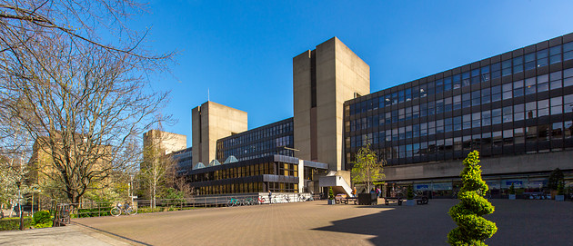
Many rivers to cross? Navigating the challenging terrains of assessment in education
INSTITUTE OF EDUCATION
Professor Mary Richardson Mary.Richardson@ucl.ac.uk
@miriched
Notes:
The one continuous factor in most education systems around the world seems to be change of one kind or another. Such changes might be invoked by decisions of a political, social, national, local, or even personal nature, but they share a common feature – an impact, somewhere, on the lived experience of students and their teachers.
Change is not something that humans seem to like and when it affects a critical aspect of our lives, as educational assessment does, the anxiety and concerns about its value are brought into sharp focus. However, it doesn’t need to be this stressful and in this talk I will consider how we, as an assessment community:
should plan effectively for change in our practice
should create networks to share practice and improve understanding of assessment
should build bridges that invoke trust within and between those networks
As the philosopher Thomas Paine said “We have it in our power to begin the world over again” and we have the expertise and knowledge as a community to enact substantive and valuable change – not necessarily to begin again, but to build alternatives to systems that don’t benefit individuals, societies and nations. We can take this challenge and use it to continue to improve the role of assessment in education.

Slide 2
The aims of assessment in education – for all of us who are a part of this ‘world’:
plan effectively for change in our practice
create networks to share practice and improve understanding of assessment
build bridges that invoke trust (and understanding) within and between those networks

Slide 3
Challenging [and changing] narratives
Should we change things?
What should we change in assessment?
How do we enact change in a coherent way?
An example…

Slide 4
Decolonization of assessment
Assessment outcomes (especially qualifications) in England include an attainment ‘gap’ (Education Endowment Foundation, 2017)
The ‘gap’ appears to be linked to background, opportunities and disadvantage. It clashes with the goal of England’s Dept for Education of claiming that,
‘Equality and diversity are critical to delivering the Department for Education (DfE)’s vision’ (DfE, 2022:np)

Slide 5
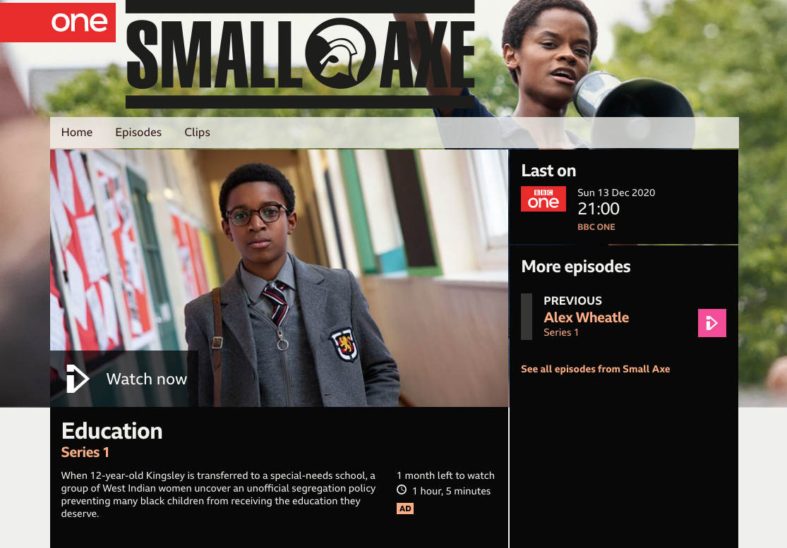
Decolonization of assessment
‘Only if the potion contains health care, childcare, good housing, sufficient income for every family, child rearing environments free of drugs and violence, support for parents in all their roles, and equal education for all students in school. Without these necessities, only magic will make that happen’
(Zigler, 2003:12).
McQueen, S. (2020) Small Axe: Education. Television series, BBC United Kingdom. Available at: https://www.bbc.co.uk/iplayer/episode/m000qfb1/small-axe-series-1-education
Notes:
There is little research relating to assessment and decolonisation, but research from Canada (see Eizadirad, 2019) presents compelling arguments and some valuable frameworks on which to build new ways of seeing assessment policy and practice. His research suggests that action is required ‘beyond simply acknowledging barriers and systemic challenges’ (Eizadirad, 2019:190) and that there is a need to enact change that rests on ‘a policy and praxis shift from an equality to equity lens’ (p205).

Slide 6
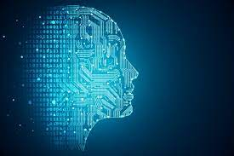
Creating [new] networks
As individuals
As experts
With a global view
Hearing and listening
Notes:
Stakeholders, from the policy makers at DfE, the subject teams in awarding bodies down to individual teachers in schools, all have some contribution to make in the support and security of an equitable environment that affords all students equal opportunities to learn and work towards qualifications. Such opportunities should not exist only at certain points in education or schooling because decolonisation is relevant well beyond the doors of the school, college or university

Slide 7
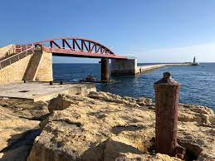
Building bridges and trust
Entitlement as a precondition of assessment literacy
Trust matters – as much as having confidence matters
Building bridges– creating improved links between those who create assessment, those that enact it and those who use it.

Slide 8
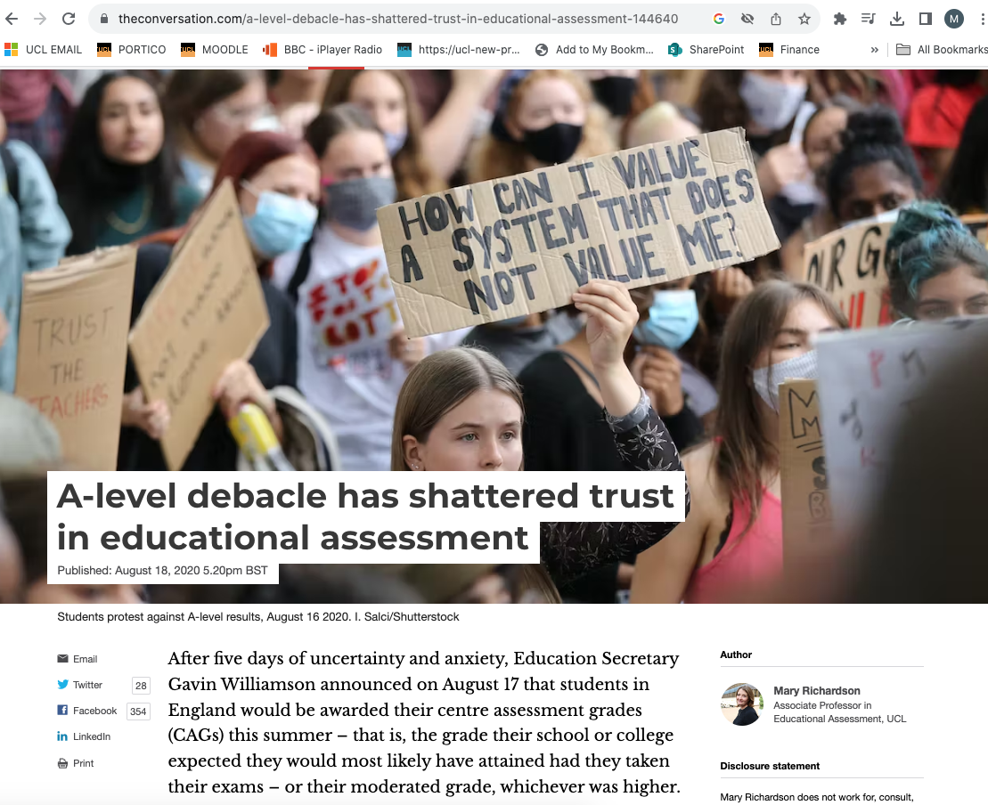
Reshaping views of assessment
discourses of confidence: engendering confidence in assessment systems both within and beyond formal educational settings
discourses for reshaping: creating evidence-​based understanding of assessment to support change in policy and practice.
https://theconversation.com/a-level-debacle-has-shattered-trust-in-educational-assessment-144640
Notes:
Seeing education as a collective endeavour means that the work of decolonisation extends beyond the school gates and as Eizadirad explains, this is why change will come, indeed he says it is inevitable as long as there is a collective commitment to make it happen. There is no magic potion, or spell; change will come from enacting change and demanding that the gap is closed not minded.

Slide 9
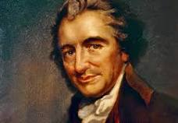
Please contact me if you’d like to talk more about how we change discourses relating to assessment in education:
Mary.richardson@ucl.ac.uk
@miriched
We have it in our power to begin the world over again. (Appendix)
Paine, T. (n.d.). The Writings of Thomas Paine — Volume 1 (1774-1779): The American Crisis. Project Gutenberg.

