Slide 1
Welcome Therese N. Hopfenbeck President AEA-Europe Director Assessment and Evaluation Research Centre University of Melbourne Visiting Fellow, Kellogg College, University of Oxford
25th Annual Meeting of the Association for Educational Assessment – Europe, 6th – 9th November 2024

Slide 2
Celebrating 25 years of conferences
Advances in Educational Assessment Practices: Considering the use of Technology, Artificial Intelligence, and Process Data for Assessment in the 21st Century

Slide 3
Serving our community
What unites us
Integrity
High Quality Research
Compassion
Commitment to collaboration

Slide 4
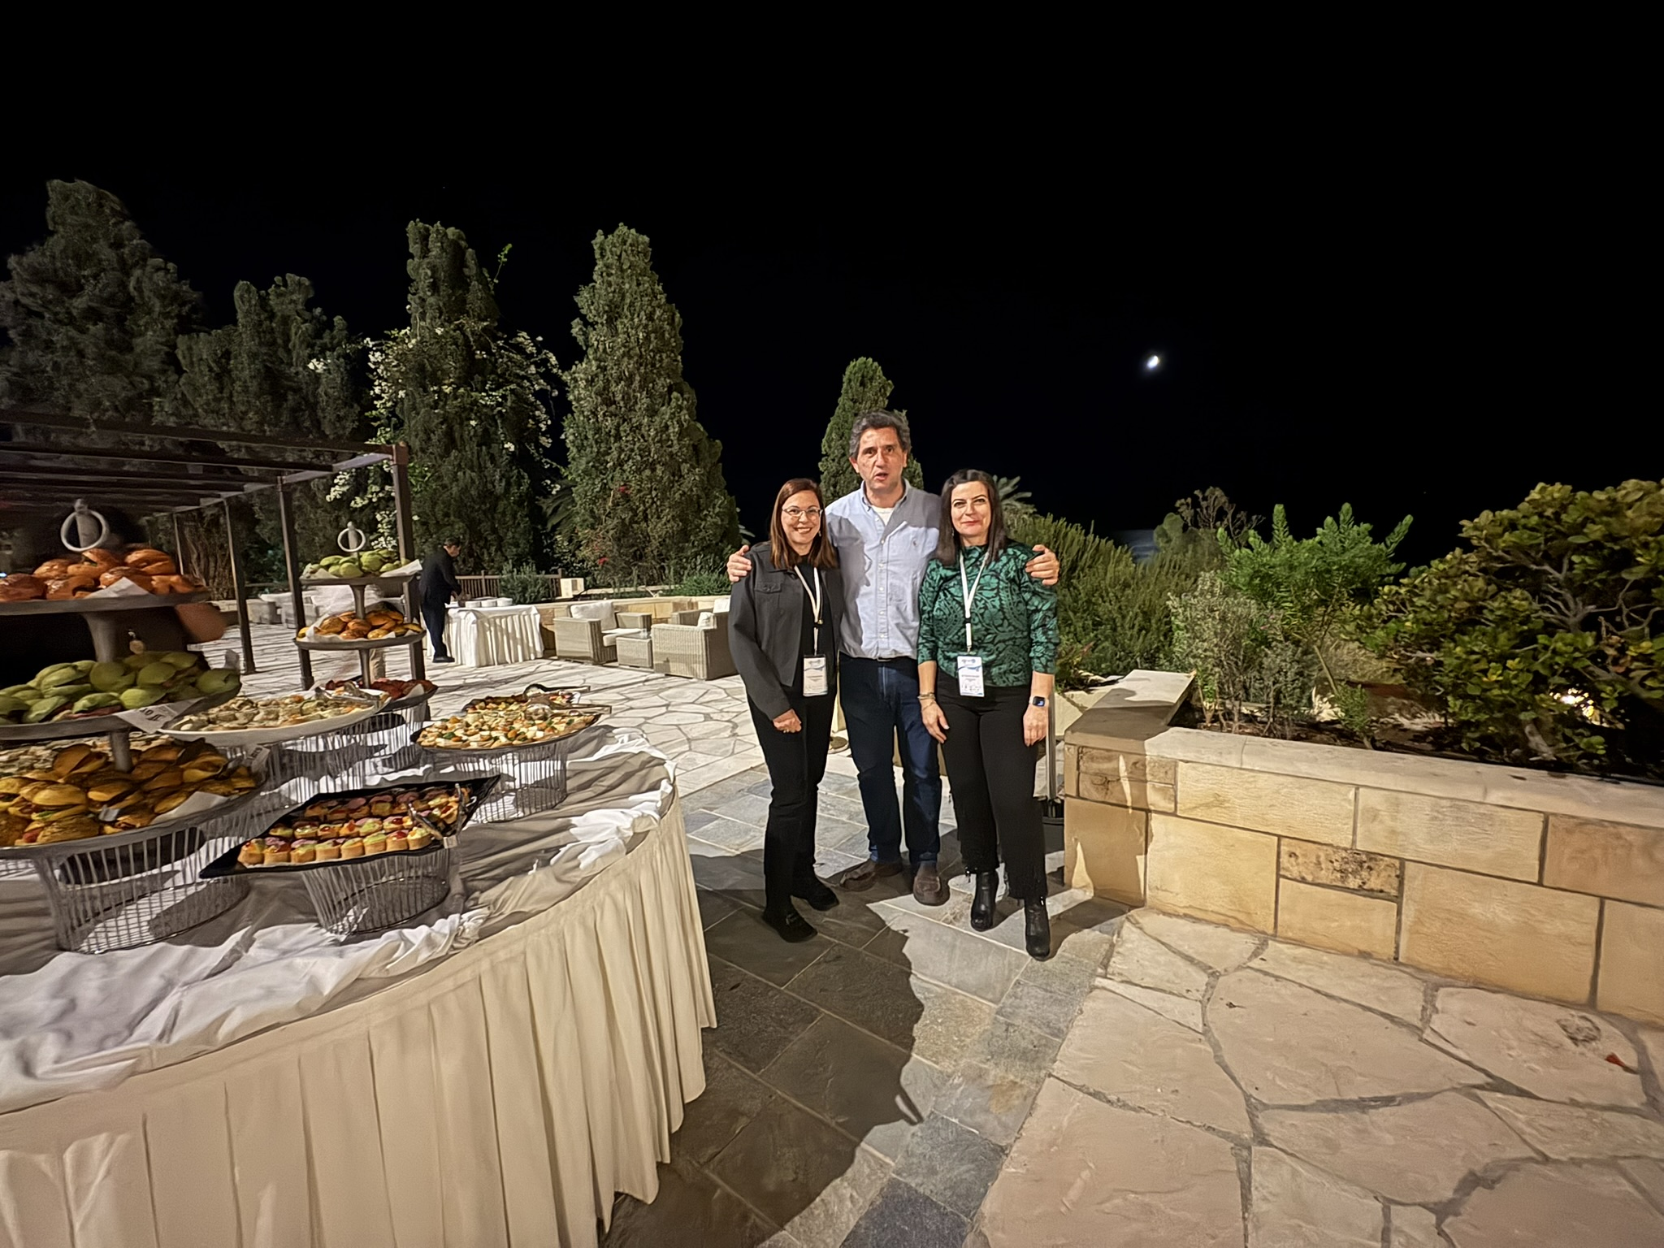
Australia
Azerbaijan
Belgium
Canada
Chile
Cyprus
Czech Republic
Estonia
France
Germany
Greece
India
Ireland
Kazakhstan
Latvia
Malta
Mexico
Netherlands
New Zealand
Norway
Portugal
Russia
South Africa
Spain
Sweden
United Kingdom
Uruguay
USA

Slide 5
Acknowledgments
Sponsors
Keynote speakers
Current and previous council members
Reviewers
Committee members
Audit committee members
First time at the conference
Those who has been at EVERY conference

Slide 6
AEA Europe new researcher awards
2024: Heather Kayton, University of Oxford, UK
2023: Dr Vasiliki Pitsia, Educational Research Centre (ERC), Ireland
2022: Dr. Paula Lehane, School of Inclusive and Special Education in Dublin City University (DCU), Ireland
2021: Raphaël Pasquini, University of Teacher Education state of Vaud, Switserland
2020: Dr. Stéphanie Berger, University of Zurich, Switzerland
2019: Dr. Aisling Keane, Queen’s University Belfast, Northern Ireland
2018: Dr. Maria Bolsinova, ACT Business Solutions, ACTNext, Amsterdam, The Netherlands
2017: Dr. Fazilat Siddiq, Nordic Institute for Studies in Innovation, Research and Education (NIFU), Norway
2016: Dr. Sebastiaan De Klerk, PhD Student at eX:plain and the Research Center for Examinations and Certification, The Netherlands
2015: Ronny Scherer, Centre for Educational Measurement at the University of Oslo, Norway
2014: Yasmine El Masri, Oxford University Centre for Educational Assessment, UK
2013: Fabienne Van Der Kleij, CITO, Netherlands
2012: Maria Teresa Florez, Oxford University Centre for Educational Assessment, UK
2011: Matthieu Brinkhuis, Cito Psychometric Research Center, Netherlands
2010: Therese Nerheim Hopfenbeck, University of Oslo, Norway
2009: Saskia Wools, CITO, The Netherlands
2008: Antonella Poce, University Roma Tre, Italy
2007: Hanna Eklof, Umea University, Sweden

Slide 7
Yasmine El Masri (2014)
There will always be something lost in translation when trans-adapting assessments.
Our job is to minimize the impact of what's been lost on students' opportunities of success.

Slide 8
CELEBRATING 25 ANNUAL CONFERENCES
aea-europe.net

Slide 9
Starting AEA-Europe
Since Monday April 3rd, 2000, AEA-Europe exists as an Association under Dutch law. This was the result of signing a legal document containing the Associations’s constitution by Emma Nardi (president), Steven Bakker (executive secretary) and Chris Whetton (treasurer) and a notary during a brief ceremony in Arnhem, The Netherlands.

Slide 10
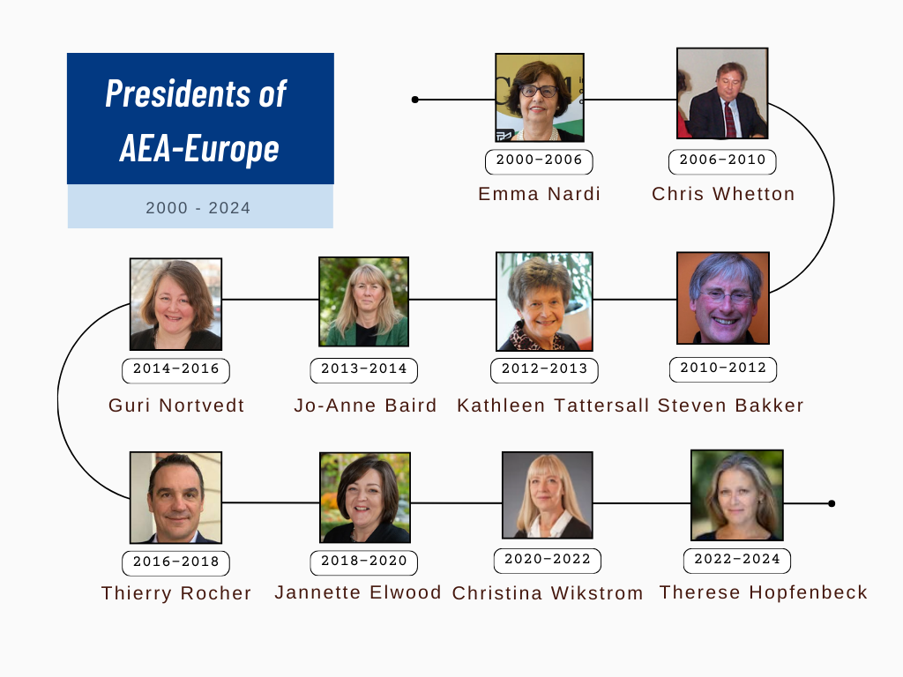

Slide 11
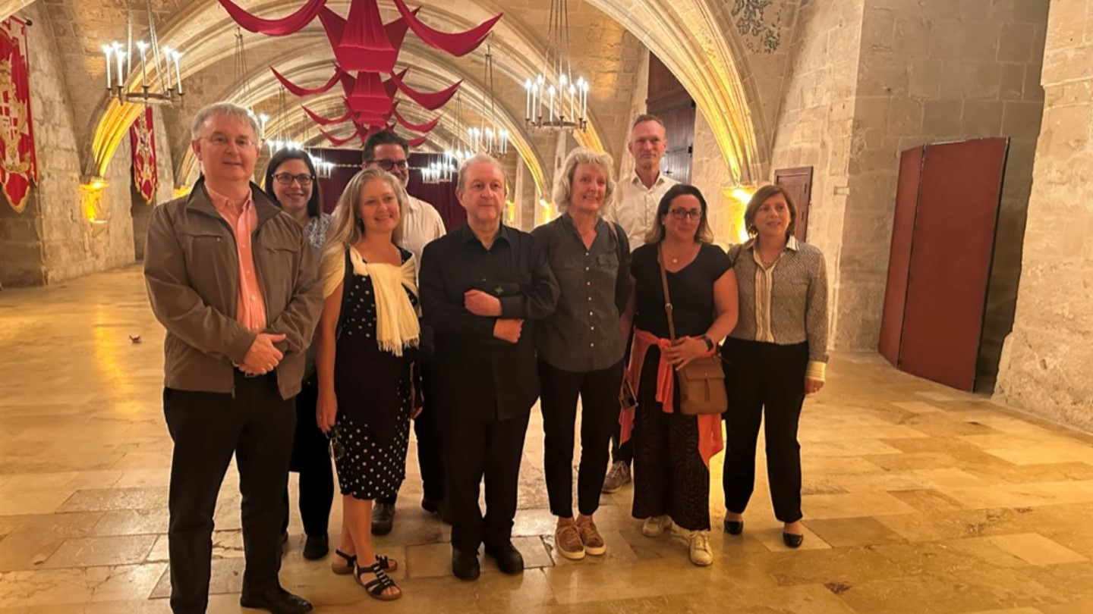

Slide 12
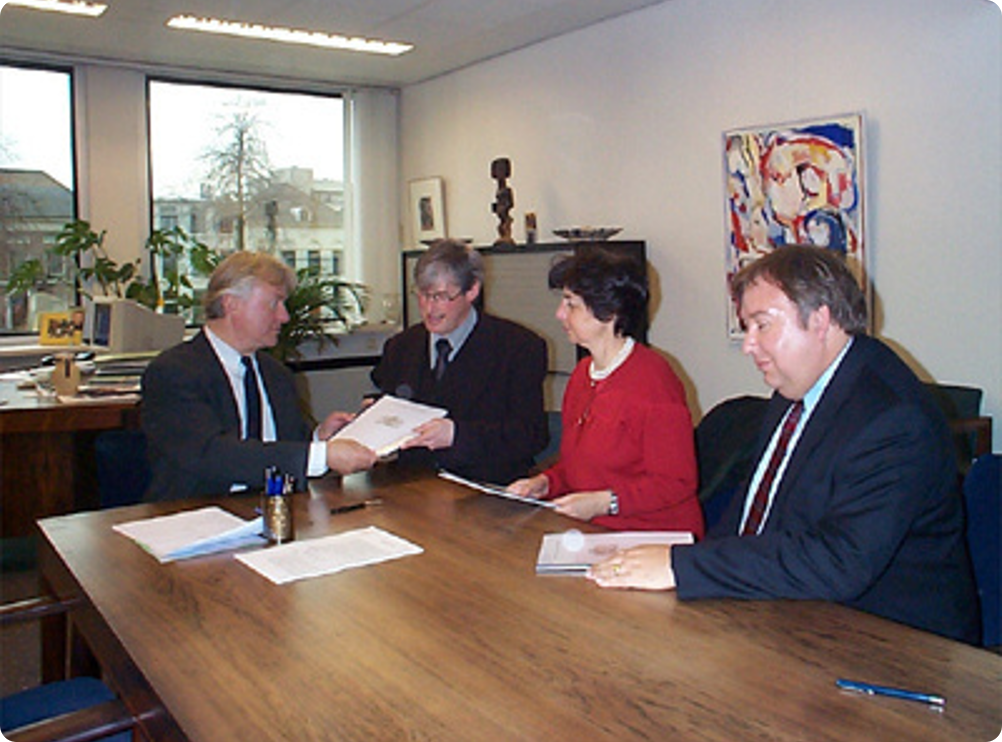
Page 8
Emma Nardi
First President of AEA-Europe
Emma served as President from 2000 to 2006. She convened the first AEA-Europe Conference in Prague between the 9th and 12th November 2000.
She is currently president of the International Council of Museums.

Slide 13
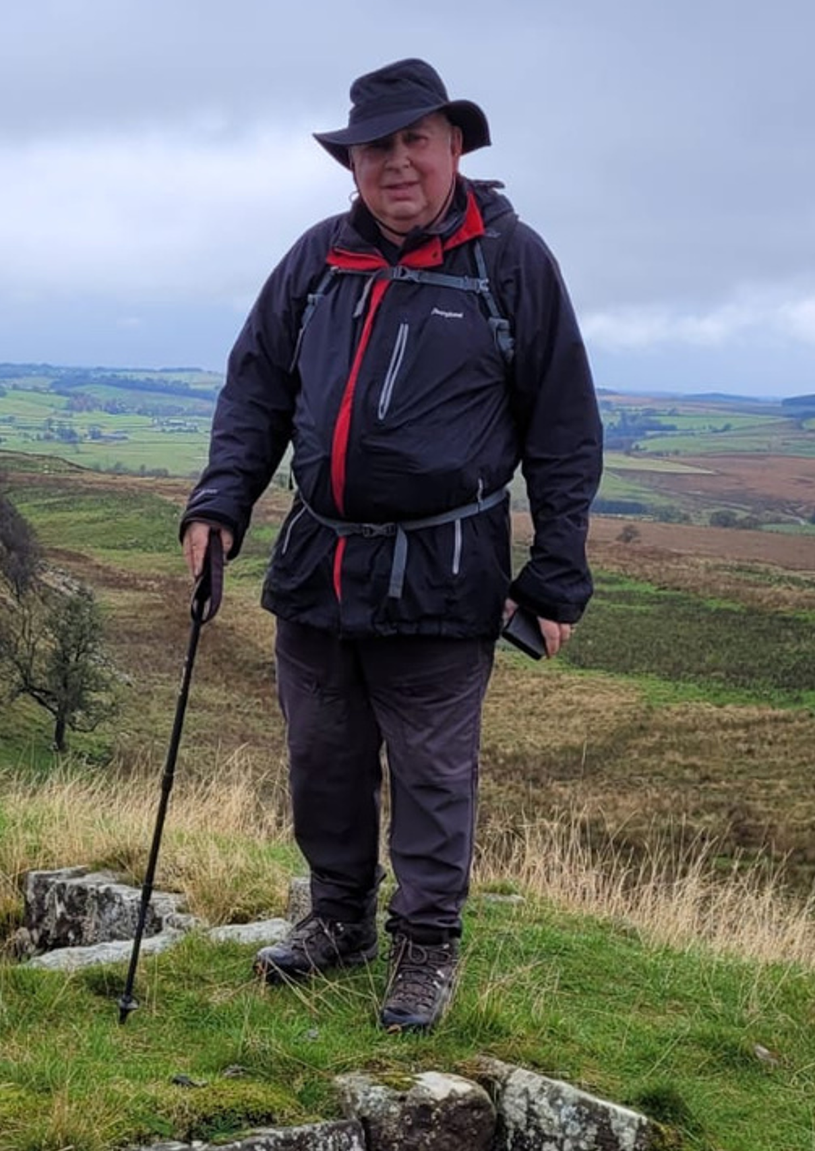
Chris Whetton
I send my greetings to those of you I remember and my congratulations to everyone on being part of such a vibrant organisations. I am very proud of the role I had in building AEA-Europe and working to set up its objectives, devising a constitution, raising funds and drumming up the first membership. Those early steps gave the foundations for the Association today and the objectives remain in place.
As organisations mature and grow, more formality is needed. I felt this keenly in my period as the second President from 2006 to 2010. We returned to the purposes of the organisation and introduced measures to raise its status and usefulness for members. These included the accreditation scheme, the New Researcher Award and changes to democratise the Council introducing elected Presidents and Vice-Presidents. I am please that all these innovations have continued to this day.
To those who are thinking this is boring old history, you are right. You are now in a different world. As I found on Hadrian’s Wall even its builders changed their designs as times changed, altering and rebuilding. I’m sure you’ll do the same and my best wishes for your endeavours.
Walking the course of Hadrian’s wall

Slide 14
First communication with AEA-Europe members
Steven Bakker
After the idea for establishing a European association for educational assessment had emerged during the 1998 IAEA conference in Barbados a small group convened in 1999 to suit the action to the word and act as the first Council of the new-born association.
2000 saw the first conference of the young association, in Prague. My main worry was the turn out. Would we attract enough attendees, would we grow and would this initiative sustainable? For Prague, some 80 colleagues registered, and since then the association slowly expanded to the numbers we see now, developing into a true platform for all involved in educational assessment, in Europe but also beyond. I am proud for having served AEA-E as a Council member for over 12 years.

Slide 15
Jo-Anne Baird

Slide 16
Conference 2008
Berlin 2012
Communications Committee

Slide 17
Page 8
Guri Nortvedt
This picture, taken at the AEA-Europe 2015 conference in Glasgow, illustrates what I have always valued about AEA-E: meeting up with colleagues and friends, to join wholeheartedly in discussion of assessment issues. The picture is taken shortly after Bruno Zombo’s keynote talk, showing him talking to Louise Hayward, Thierry Rocher, Guri A. Nortvedt and George Mc Bride. George is the main reason I chose this picture as he represents another aspect about AEA E that I value: members devoting time and effort into making the association what it is building this association that is Our’s.

Slide 18
Thierry Rocher

Slide 19
Jannette Elwood

Slide 20
Christina Wikström
I have been an active member of AEA-Europe for many years, serving in various capacities, including roles in committees, as a council member, executive secretary, vice president, and president. I also take pride in having attended every AEA-Europe conference to date!
Witnessing the association’s evolution over the years has been a fantastic experience. It’s truly a success story, and I am deeply grateful for the opportunity to have been part of this incredible journey. In my view, AEA-Europe is a unique association that plays an important role in advancing educational assessment research, policy, and practice, particularly in Europe. I am convinced that the key to its success lies in the association’s ability to grow and professionalize while maintaining a personal and welcoming atmosphere. It is a place where students, researchers, practitioners, and policymakers come together to share knowledge and ideas. AEA-Europe is an association built by and for its members, and its annual conference stands out as a highlight of the professional year, providing a natural and enriching meeting point.
Personally, and professionally, the association has been extremely important and valuable. I’ve learned a lot and have had the opportunity to meet and collaborate with colleagues from around the world, and also make lifelong friends. I hope many new members will enjoy these same opportunities in the years to come.

Slide 21
Page 6

Slide 22
THANK YOU

